Slide 1
Webpack + Micro-Frontends

Slide 2
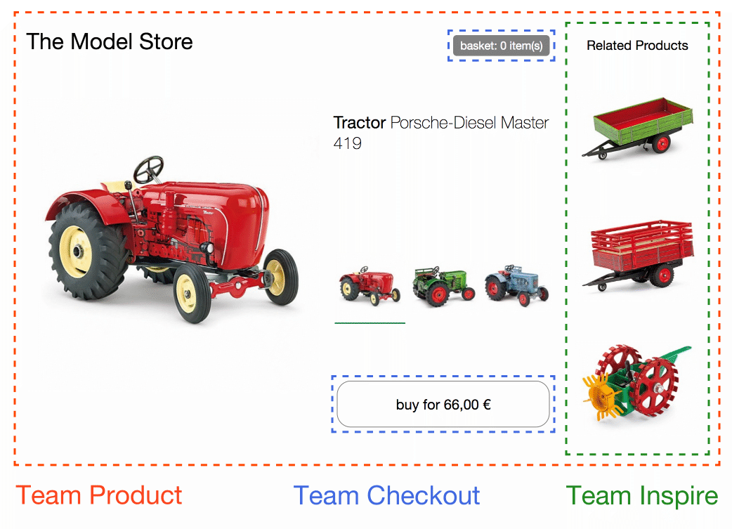
Micro-Frontends
Micro-frontend is an architectural approach that aims to decompose a frontend application into smaller, more manageable parts.

Slide 3
Advantages of Micro-Frontend
Independent Development
Isolation
Reusability
Technology agnostic
Scalability
Incremental Upgrades

Slide 4
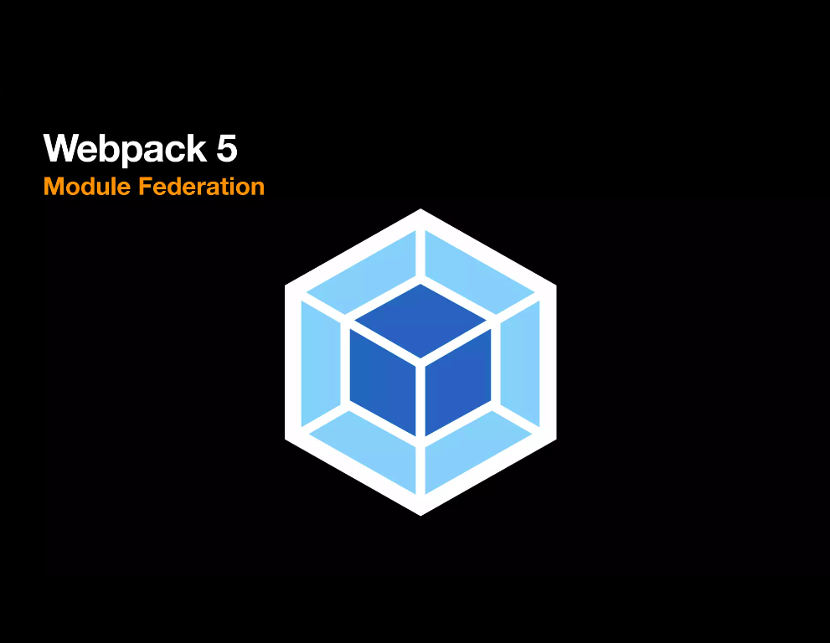
Micro-Frontends
A new way of creating a modular, composable and scalable code with JS/TS using Webpack 5 – Module Federation

Slide 5
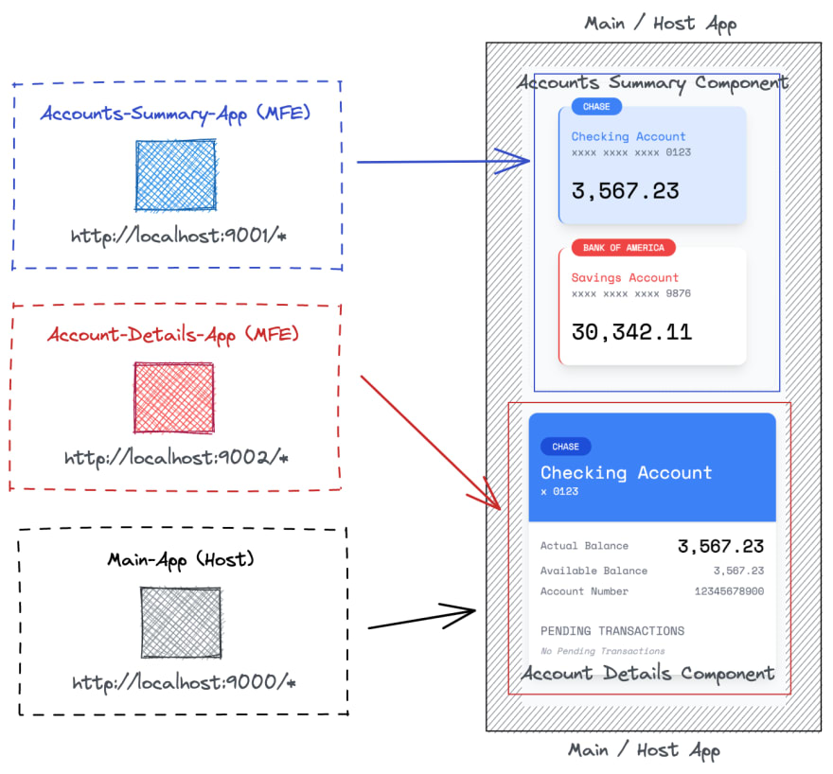
Terminologies
Host
Remotes/ MFE
Module Name
File Entry Name
Exposes
Shared

Slide 6
Configuration

Slide 7
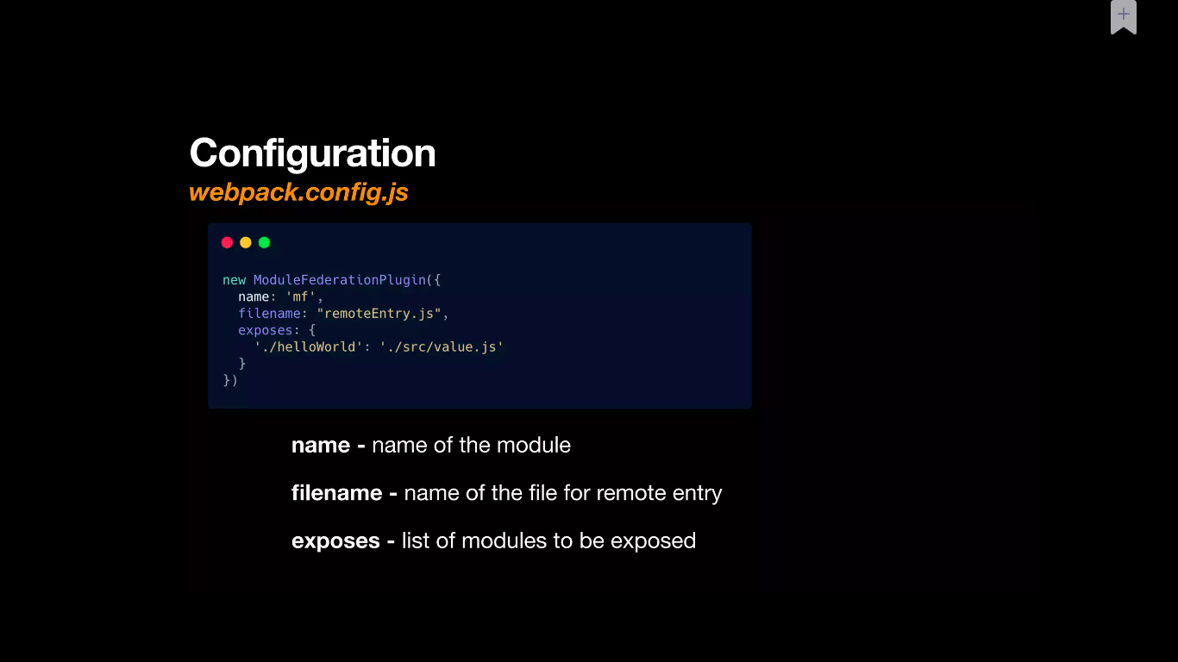

Slide 8
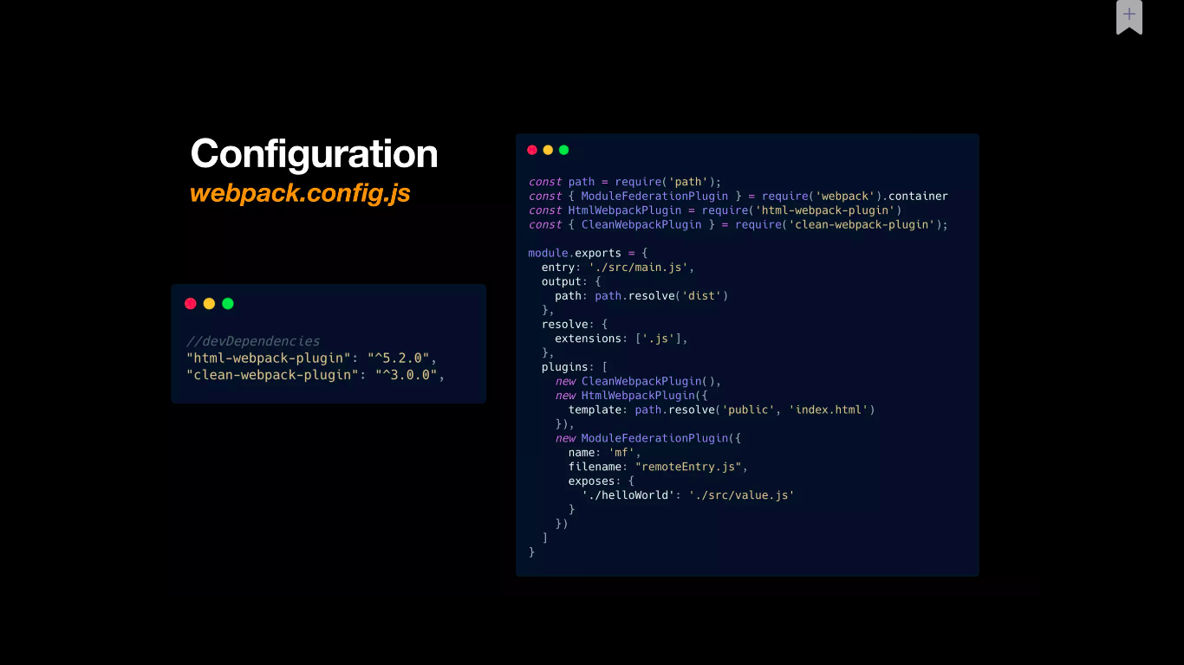

Slide 9
Work Flow

Slide 10
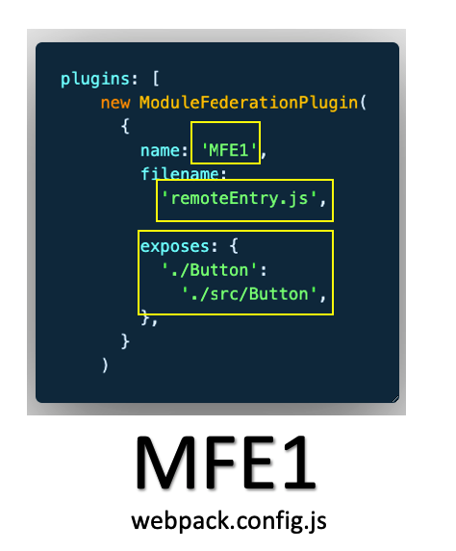
Work-Flow – Configuring Name & Exposes

Slide 11
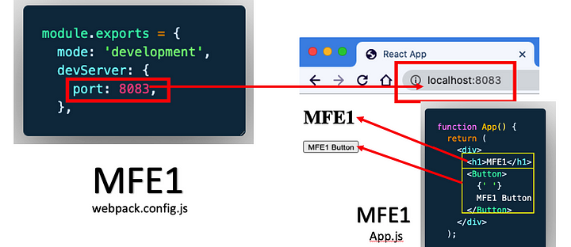
Work-Flow – Rendering the app

Slide 12
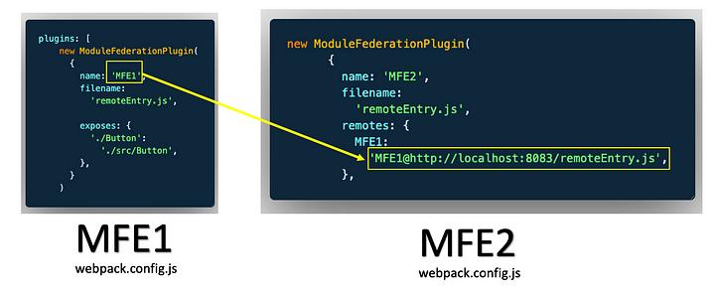
Work-Flow – Defining remotes in consumer

Slide 13
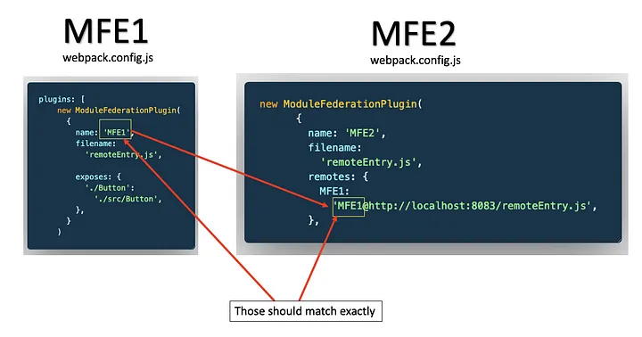
Work-Flow – Defining remotes in consumer

Slide 14
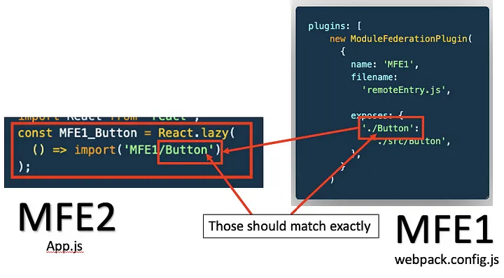
Work-Flow - Consuming remotes

Slide 15
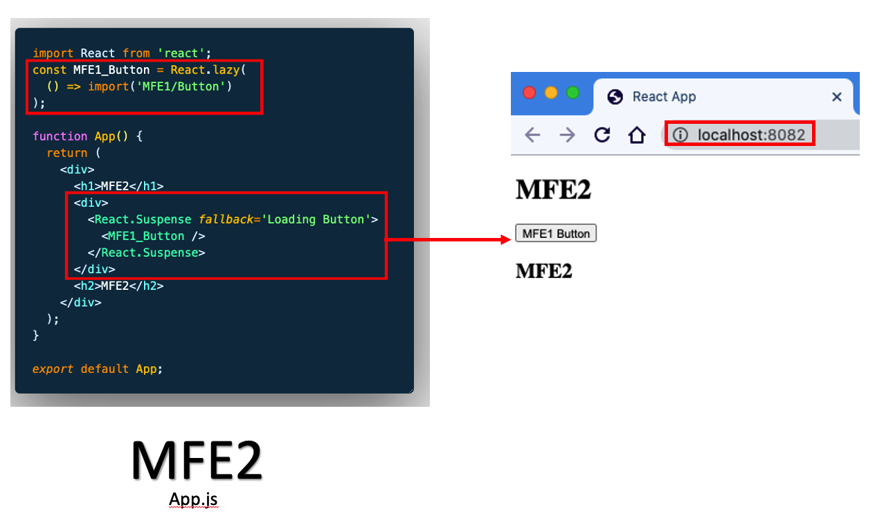
Work-Flow - Consuming remotes

Slide 16
Let's see it live...

Slide 17
Takeaway
Composable, Modular & Scalable
Components/Modules can be consumed/shared at runtime
Components/Modules need-not be bundled together
Dynamic loading is possible at runtime
UI will inherit styles & colors of the host app
Publishing updates will be seamless for web applications
Teams can work on separate modules and publish them

Slide 18

Is it bound to web-apps? Can we use it in native/mobile apps?

Slide 19
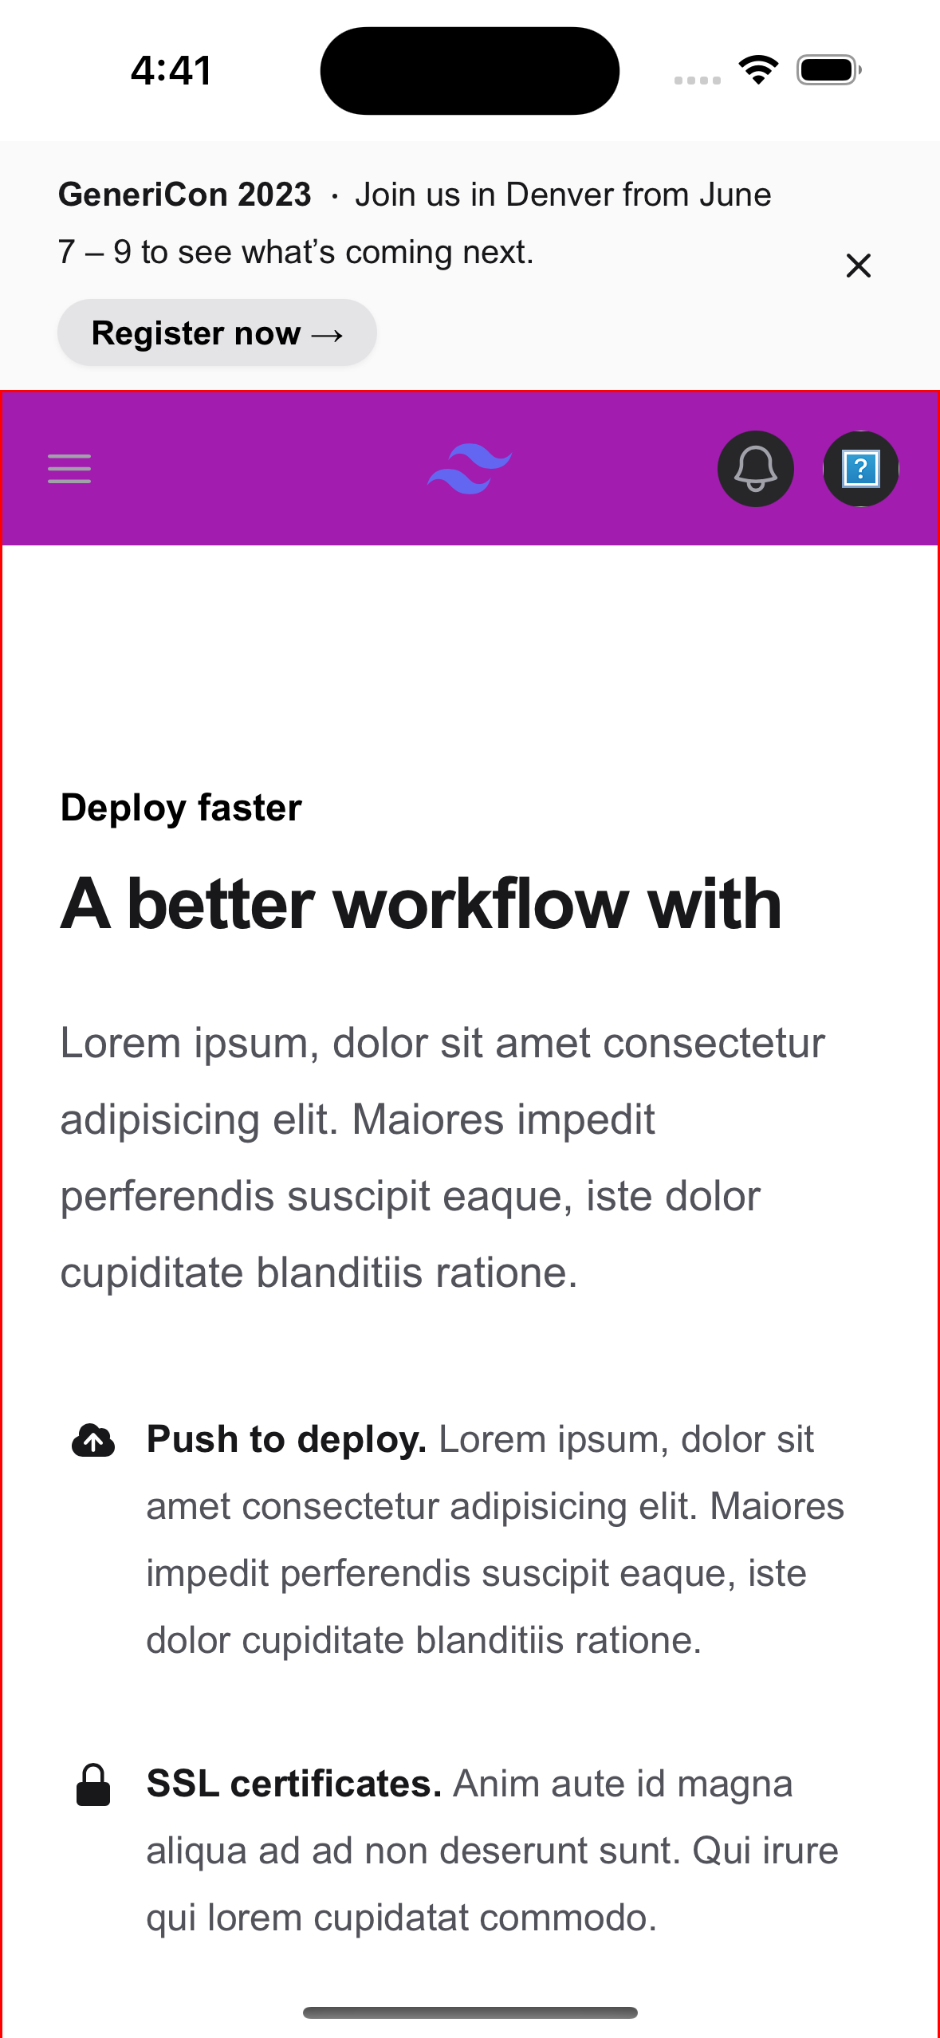
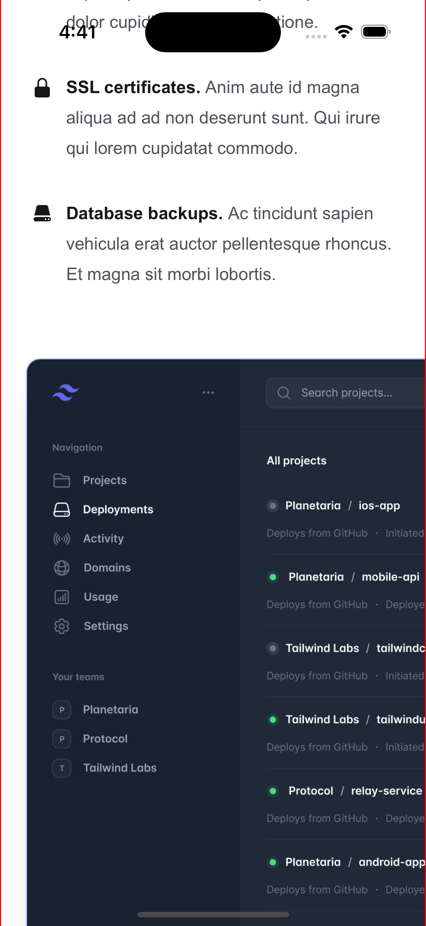
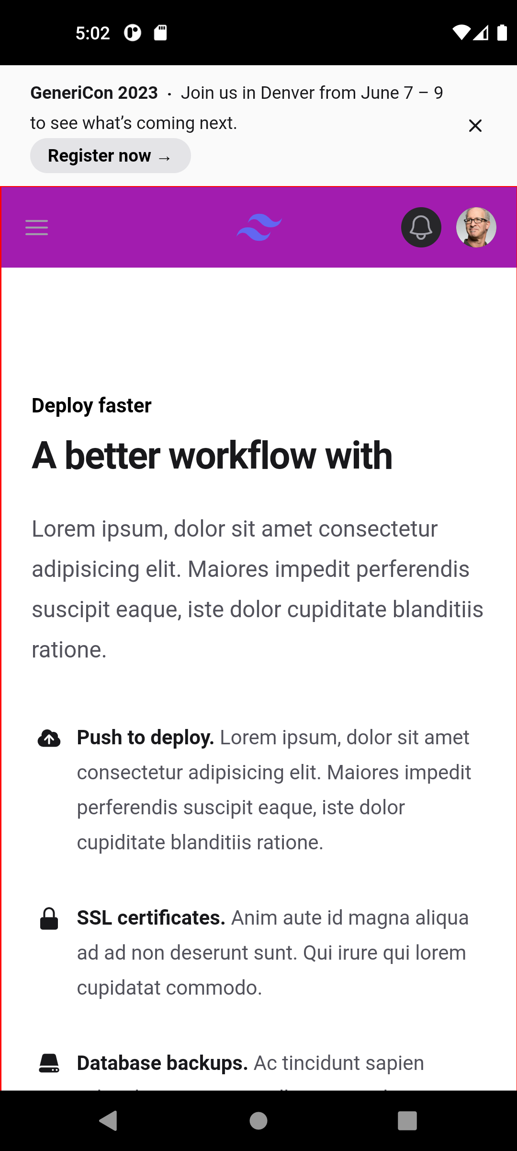
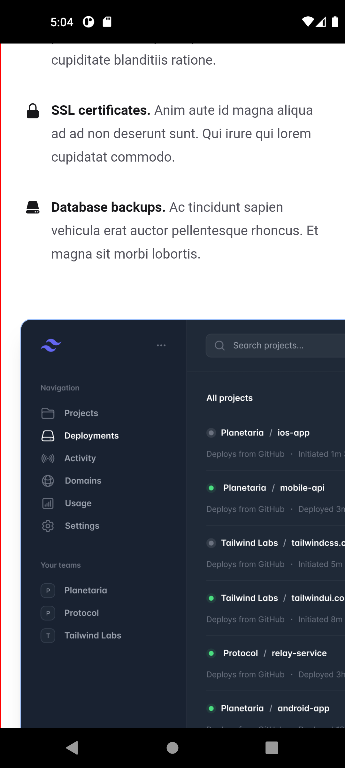
Yes
Cordova
Android
iOS

Slide 20
Takeaway
Apps will be able to access native plugin features supported in host app
Apps can be built, tested published separately
A single publish will target both mobile and web platforms
Packaging mini-apps with host app and re-publishing host app to app/play stores is not required

Slide 21


Super-Mini App Like?
Should have access to mini-apps packaged
Mini apps can be updated remotely
Re-Publishing Super-App is not required
An ecosystem of mini-apps can be built

Slide 22


